Slide 1
Impact of Isolation during a pandemic And what to do about it
Vanessa Vitiello, MS Ed.

Slide 2
Mindfulness Activity

Slide 3
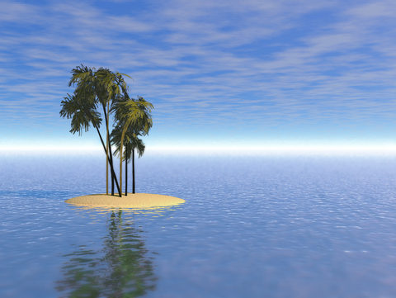
What is social isolation?
“far away from other places, buildings, people; remote”
“having minimal contact with others”
Human loneliness: by 2018, levels of loneliness in America had reached an all time high, are are climbing.
Many mental and physical health issues are related to feelings of loneliness or isolation
As social isolation increases, levels of loneliness does too
Everyone can experience this

Slide 4
COVID-19 and Isolation
Stay at home orders, quarantine, remote work and school
Loneliness has increase by 20-30% and emotional distress has tripled
COVID-19 has disproportionately impacted people of color and low-income individuals
We are relying more on digital technology especially to remain connected to others
“Loneliness paradox” “zoom fatigue”

Slide 5
Interventions for loneliness and online fatigue
Talk about the difference between being alone, and being lonely in your home
Look out for peers who may seem disconnected
Pay attention to the negative thoughts that come up and address those
Do something that makes you feel productive or that gives you purpose
Stick to doing one thing at a time→ mindfulness
Give yourself time in between to take breaks
Stick to a schedule or routine → set boundaries
Find comforting things
Distract yourself
Stay active or create something
Practice self-compassion

Slide 6
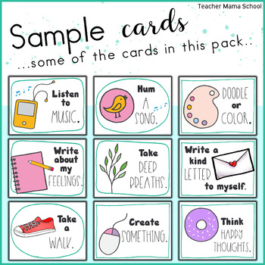
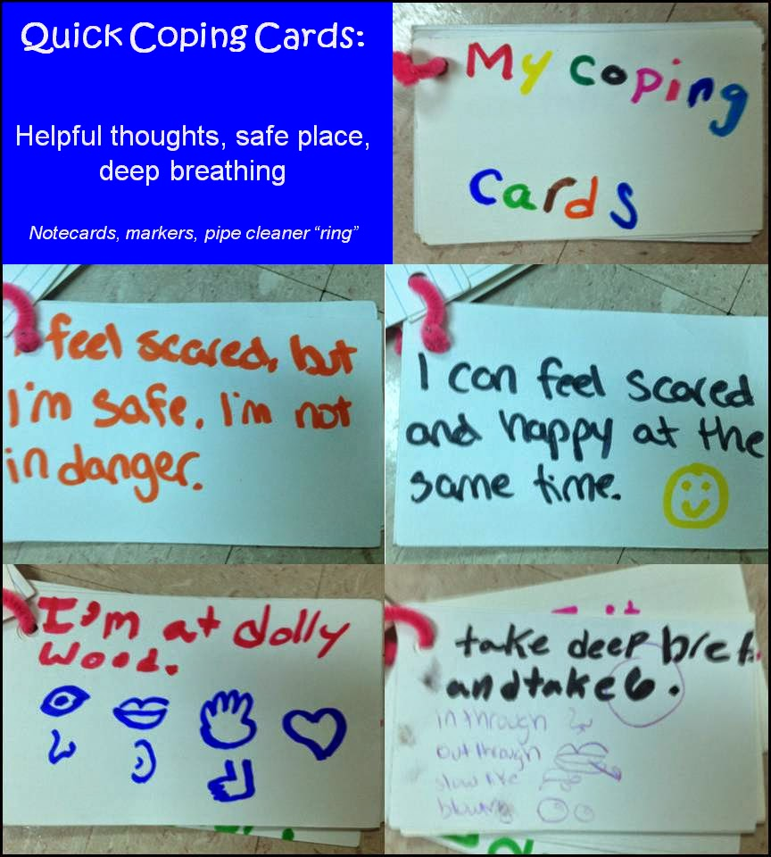
Activity: Coping Card
Grab a piece of paper, an index card or open a document on your computer!
Begin to think about things that help you feel better when you are stressed, tired, overwhelmed, sad (this can be different for everyone)
Put down at least five things that might help when you are not feeling yourself
Example:
1. Deep Breathing
2. Self-soothing- lighting a candle
3. Self Soothing- taking a hot shower
4. Taking a walk
5. Distract- watch Netflix
Add some color, drawings, stickers, clip art that make you feel good!
Take a picture on your phone of your coping card so you can easily access it
Challenge: Save it as your background for the next 5 days and practice these skills throughout the week

Slide 7
Resources
Distress tolerance skills handout
Emotion regulation skills handout
Mindfulness skills handout
Self soothing skills
SAMHSA’s National Helpline – 1-800-662-HELP (4357)
Digital Resources
Therapy for Black Girls

Slide 8
References
https://www.apa.org/monitor/2019/05/ce-corner-isolation
https://www.healthaffairs.org/do/10.1377/hblog20200609.53823#:~:text=Immediate%20effects%20of%20social%20isolation,emotional%20or%20overeating%2C%20may%20increase.
https://www.verywellmind.com/how-to-cope-with-loneliness-during-coronavirus-4799661

